Slide 1



Tree Species Classification
AUTHOR- ANISHKA SINGH

Slide 2

Learning Objectives
Understand how to prepare image datasets for classification tasks.
Learn to build a tree species classifier using deep learning.
Apply CNNs to identify and categorize tree species from images.
Evaluate the performance of a trained classification model.
Gain hands-on experience with real-world environmental data.
GOAL
Source :
www.freepik.com/

Slide 3
Tools and Technology used
Python – Programming language for development
TensorFlow / Keras – For building and training CNN models
NumPy & Pandas – Data handling and manipulation
Matplotlib / Seaborn – Visualization of data and results
OpenCV / PIL – Image loading and preprocessing
Google Colab / Jupyter Notebook – Development environment
Git & GitHub – Code and dataset version control

Slide 4
Methodology
Data Collection
Cloned image dataset from GitHub (TREESPECIES repo).
Images categorized into folders based on tree species.
Data Preprocessing
Loaded and labeled images.
Resized, normalized, and prepared images for training.
Model Building
Designed a Convolutional Neural Network (CNN) using TensorFlow/Keras.
Configured layers for feature extraction and classification.

Slide 5
Model Training
Trained the CNN model on labeled image data.
Applied techniques like data augmentation (if any).
Evaluation
Assessed model accuracy and loss on test/validation data.
Visualized performance using graphs (accuracy, loss).
Prediction & Deployment
Used the trained model to classify new tree species images.

Slide 6
Problem Statement:
Identifying tree species manually is time-consuming, error-prone, and requires expert knowledge. There is a need for an automated system that can accurately classify tree species using image data to support biodiversity conservation, forestry management, and environmental monitoring.

Slide 7
Solution:
Develop a deep learning-based image classification model using Convolutional Neural Networks (CNNs) that can automatically identify and classify tree species from images with high accuracy, reducing reliance on manual identification and enabling faster environmental assessments.

Slide 8
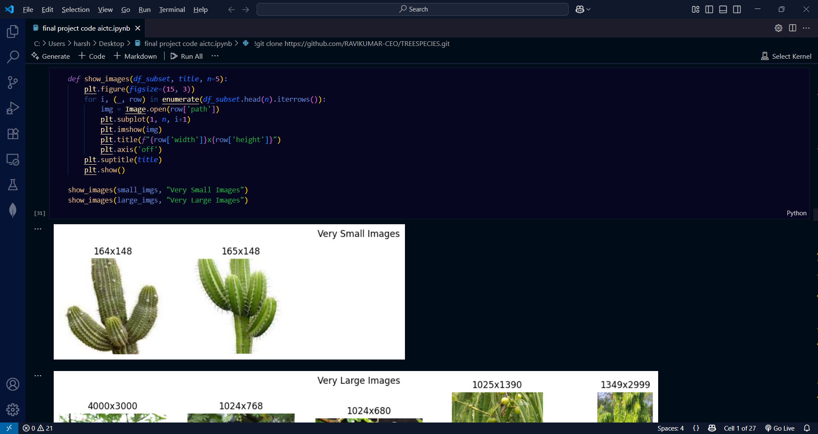
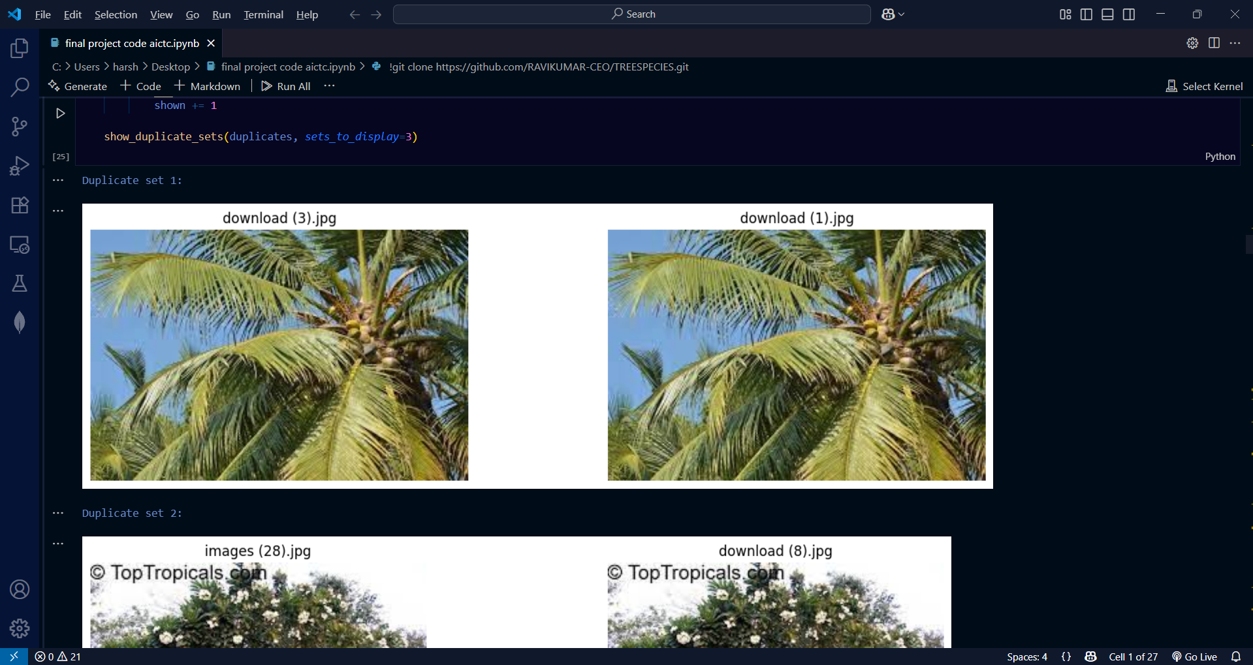
Screenshot of Output:

Slide 9

Screenshot of Output:

Slide 10
Future Enhancements:-
Integrate GPS-based recommendations for tree species suited to specific locations
Build a mobile app with real-time camera-based prediction
Expand dataset to include leaf, bark, and flower images for higher accuracy
Incorporate seasonal variation handling (e.g., leaf-off vs leaf-on conditions)
Add user feedback loop for continuous model improvement

Slide 11
Key Takeaways:-
CNNs enable fast and scalable image-based species recognition
Automated systems reduce need for expert-driven manual identification
Potential to become a valuable tool for sustainable environmental management
Project showcases the powerful synergy between AI and ecological conservation
Opens the door for future innovations in smart forestry solutions

Slide 12
Conclusion:
The tree species classification model successfully demonstrates the potential of deep learning in automating environmental monitoring. By leveraging CNNs, the system accurately identifies tree species from images, offering a fast, reliable, and scalable solution that can aid researchers, conservationists, and forest managers.

